Slide 1
Database login information
Use the following link to access the database:
www.gmvemscsodb.com

Slide 2
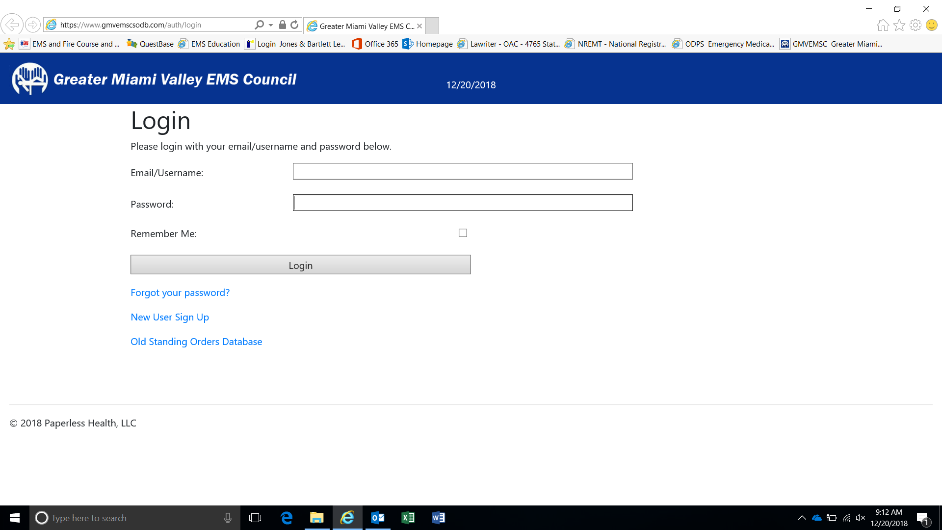
To create an account in the database, click “New User Sign Up”

Slide 3
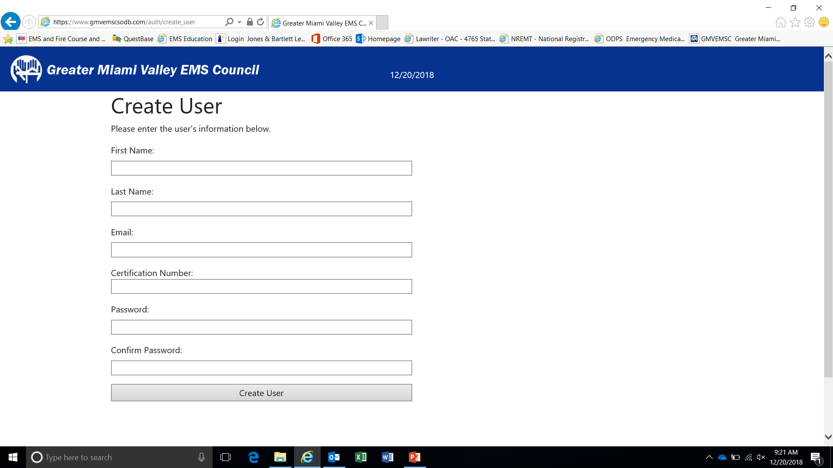
Fill out each information box
*it is recommended to enter your certification number exactly as it shows on your state card. Your state card can be used as a reference when entering your certification number into Questbase to take the CBT*
If your certification number from the database does not match questbase, the CBT score will not export

Slide 4
Enter login information and select “Login”

Slide 5
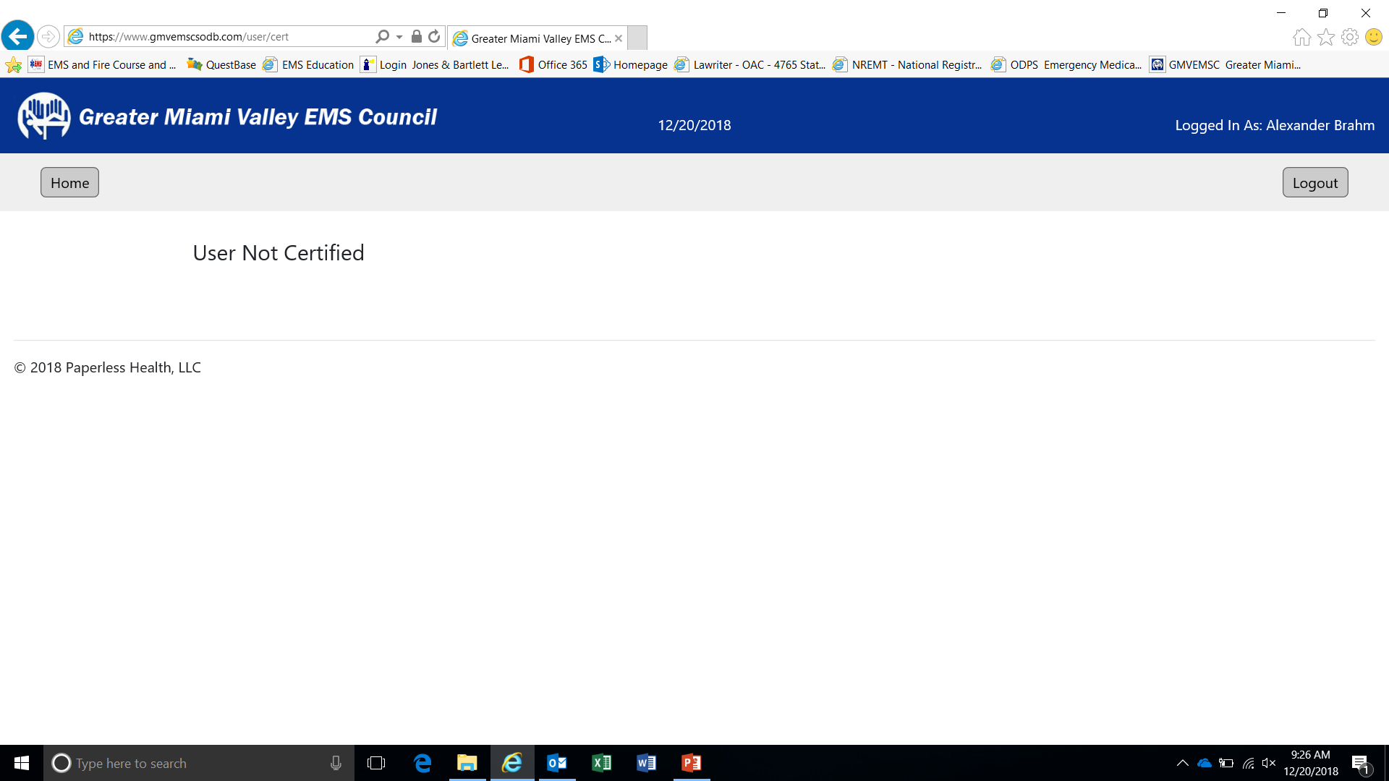
All user’s accounts must be “certified” by an administrator
Department administrators must “certify” their members
Departments administrators must send an email to Russell, John JRussell@hhoh.org or Brahm, Alexander P apbrahm@premierhealth.com to become “certified”

Slide 6
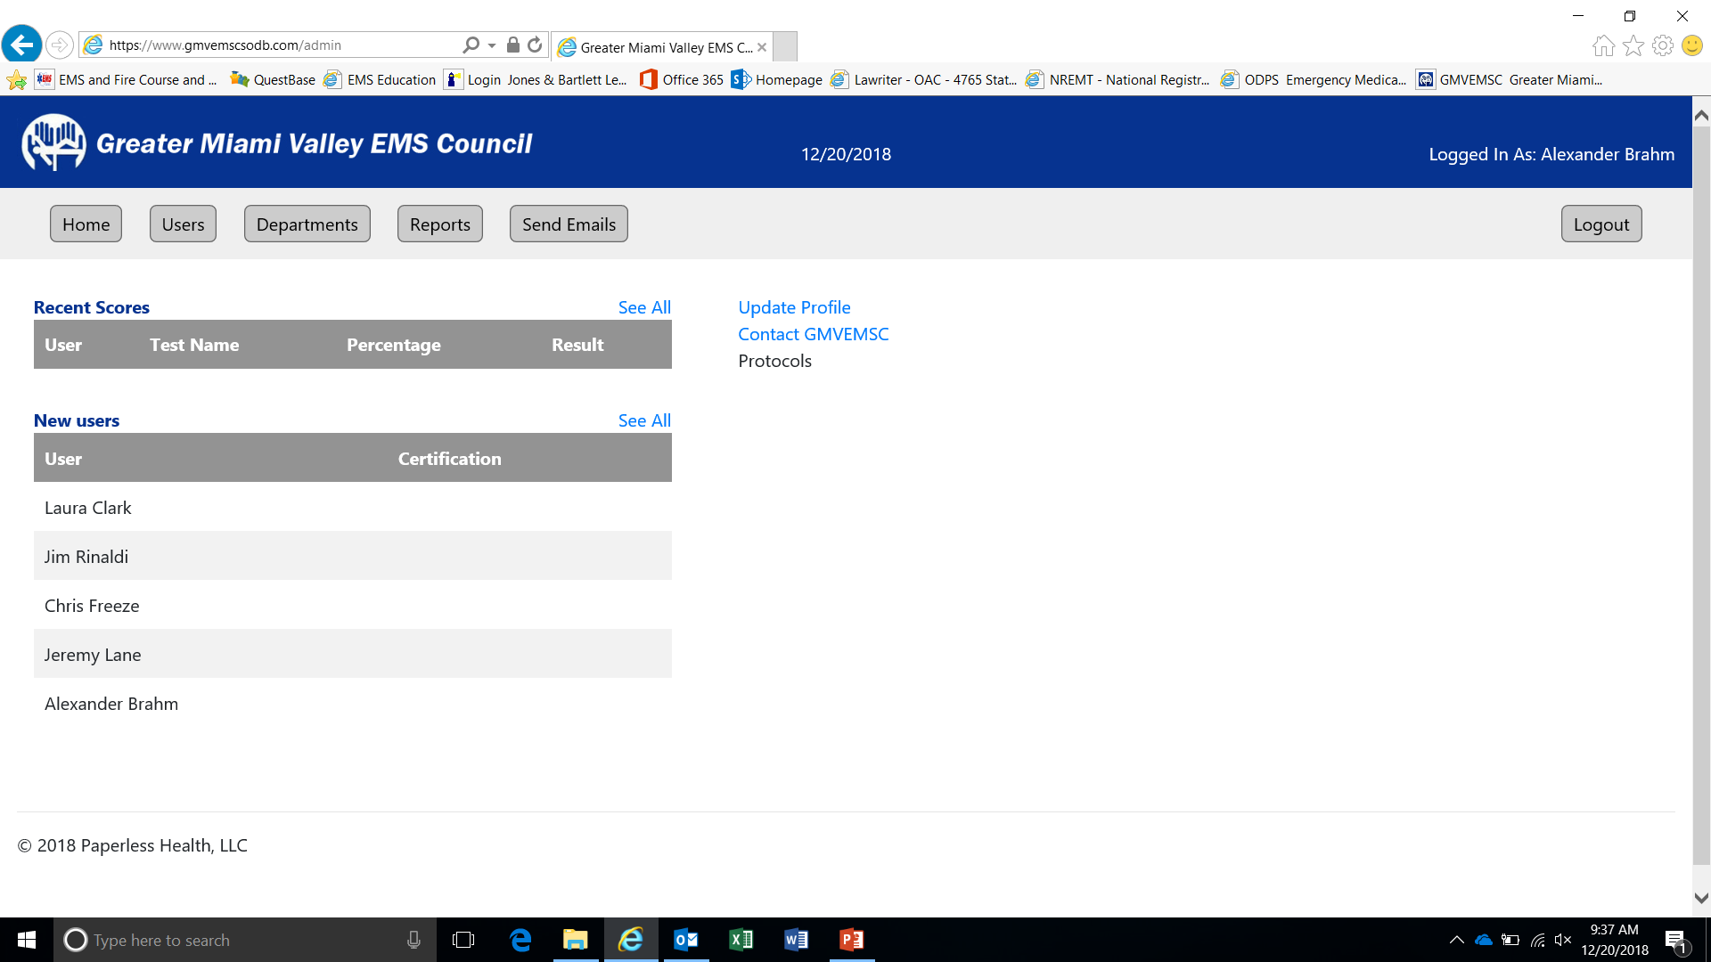
Everyone must update their profile when they create their account.
Home screen for Department Administrator

Slide 7
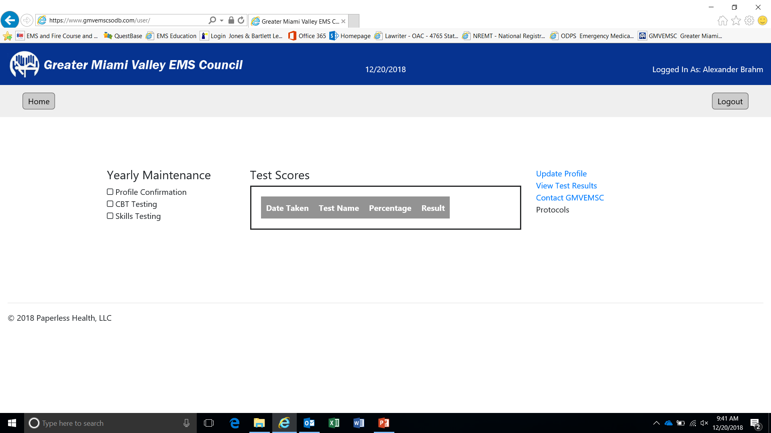
Everyone must update their profile when they create their account.
Home screen for department members

Slide 8
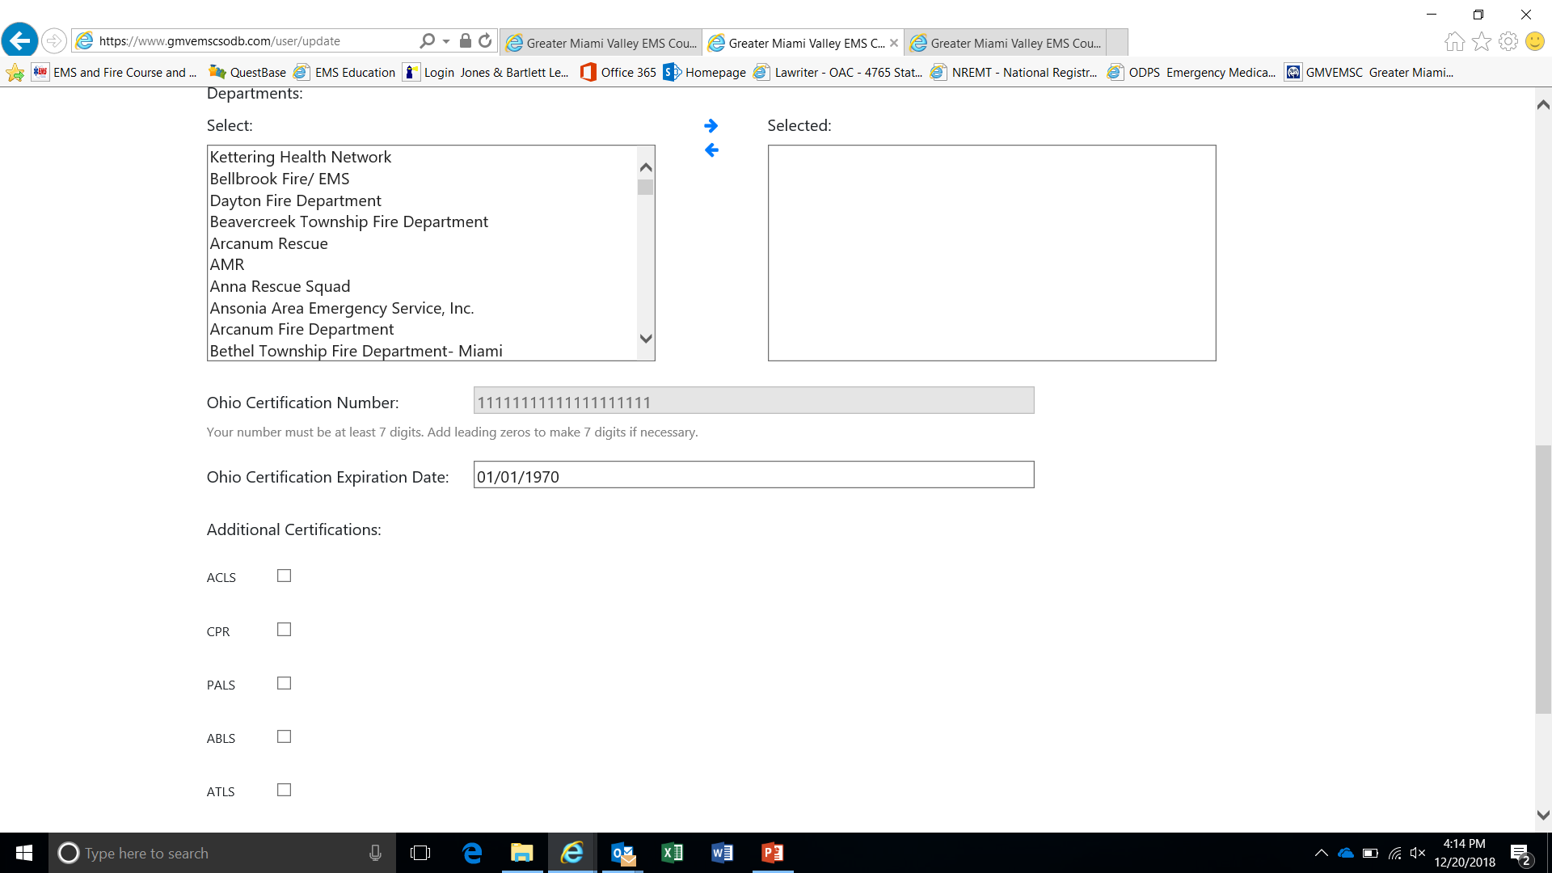
Select each department that you work for
Move them into this box by selecting the blue arrows

Slide 9
If there are any questions please contact Russell, John JRussell@hhoh.org or Brahm, Alexander P apbrahm@premierhealth.com

