Slide 1
Connecting to Zoom Meetings

Slide 2
Two ways to Connect
Online
Over the Phone

Slide 3
1. Connecting Online
Copy and paste the meeting link provided to you (probably via email) into your internet browser.
If you have never used Zoom before, you should automatically start downloading a “Zoom.exe”, if it does not start downloading please click “Download and run
Once it is done Downloading it will appear in the bottom left corner (if you are using Google Chrome), please click on it.

Slide 4
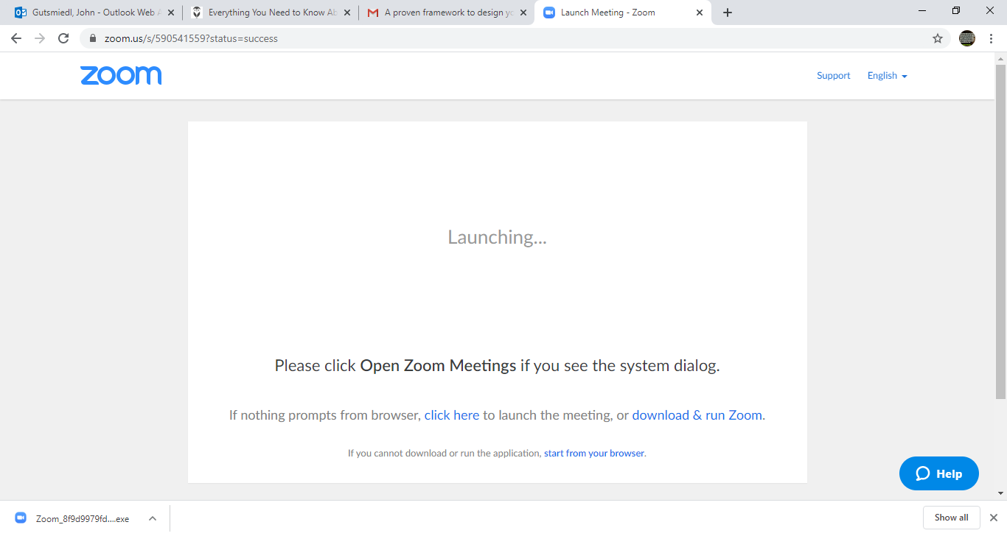
Step 2
Step 2 and 3

Slide 5
1. Connecting Online (cont.)
Once you have clicked on the installed program, a screen will appear asking for the meeting password. Please enter the provided meeting password (probably given to you via email)
Press “join meeting”

Slide 6
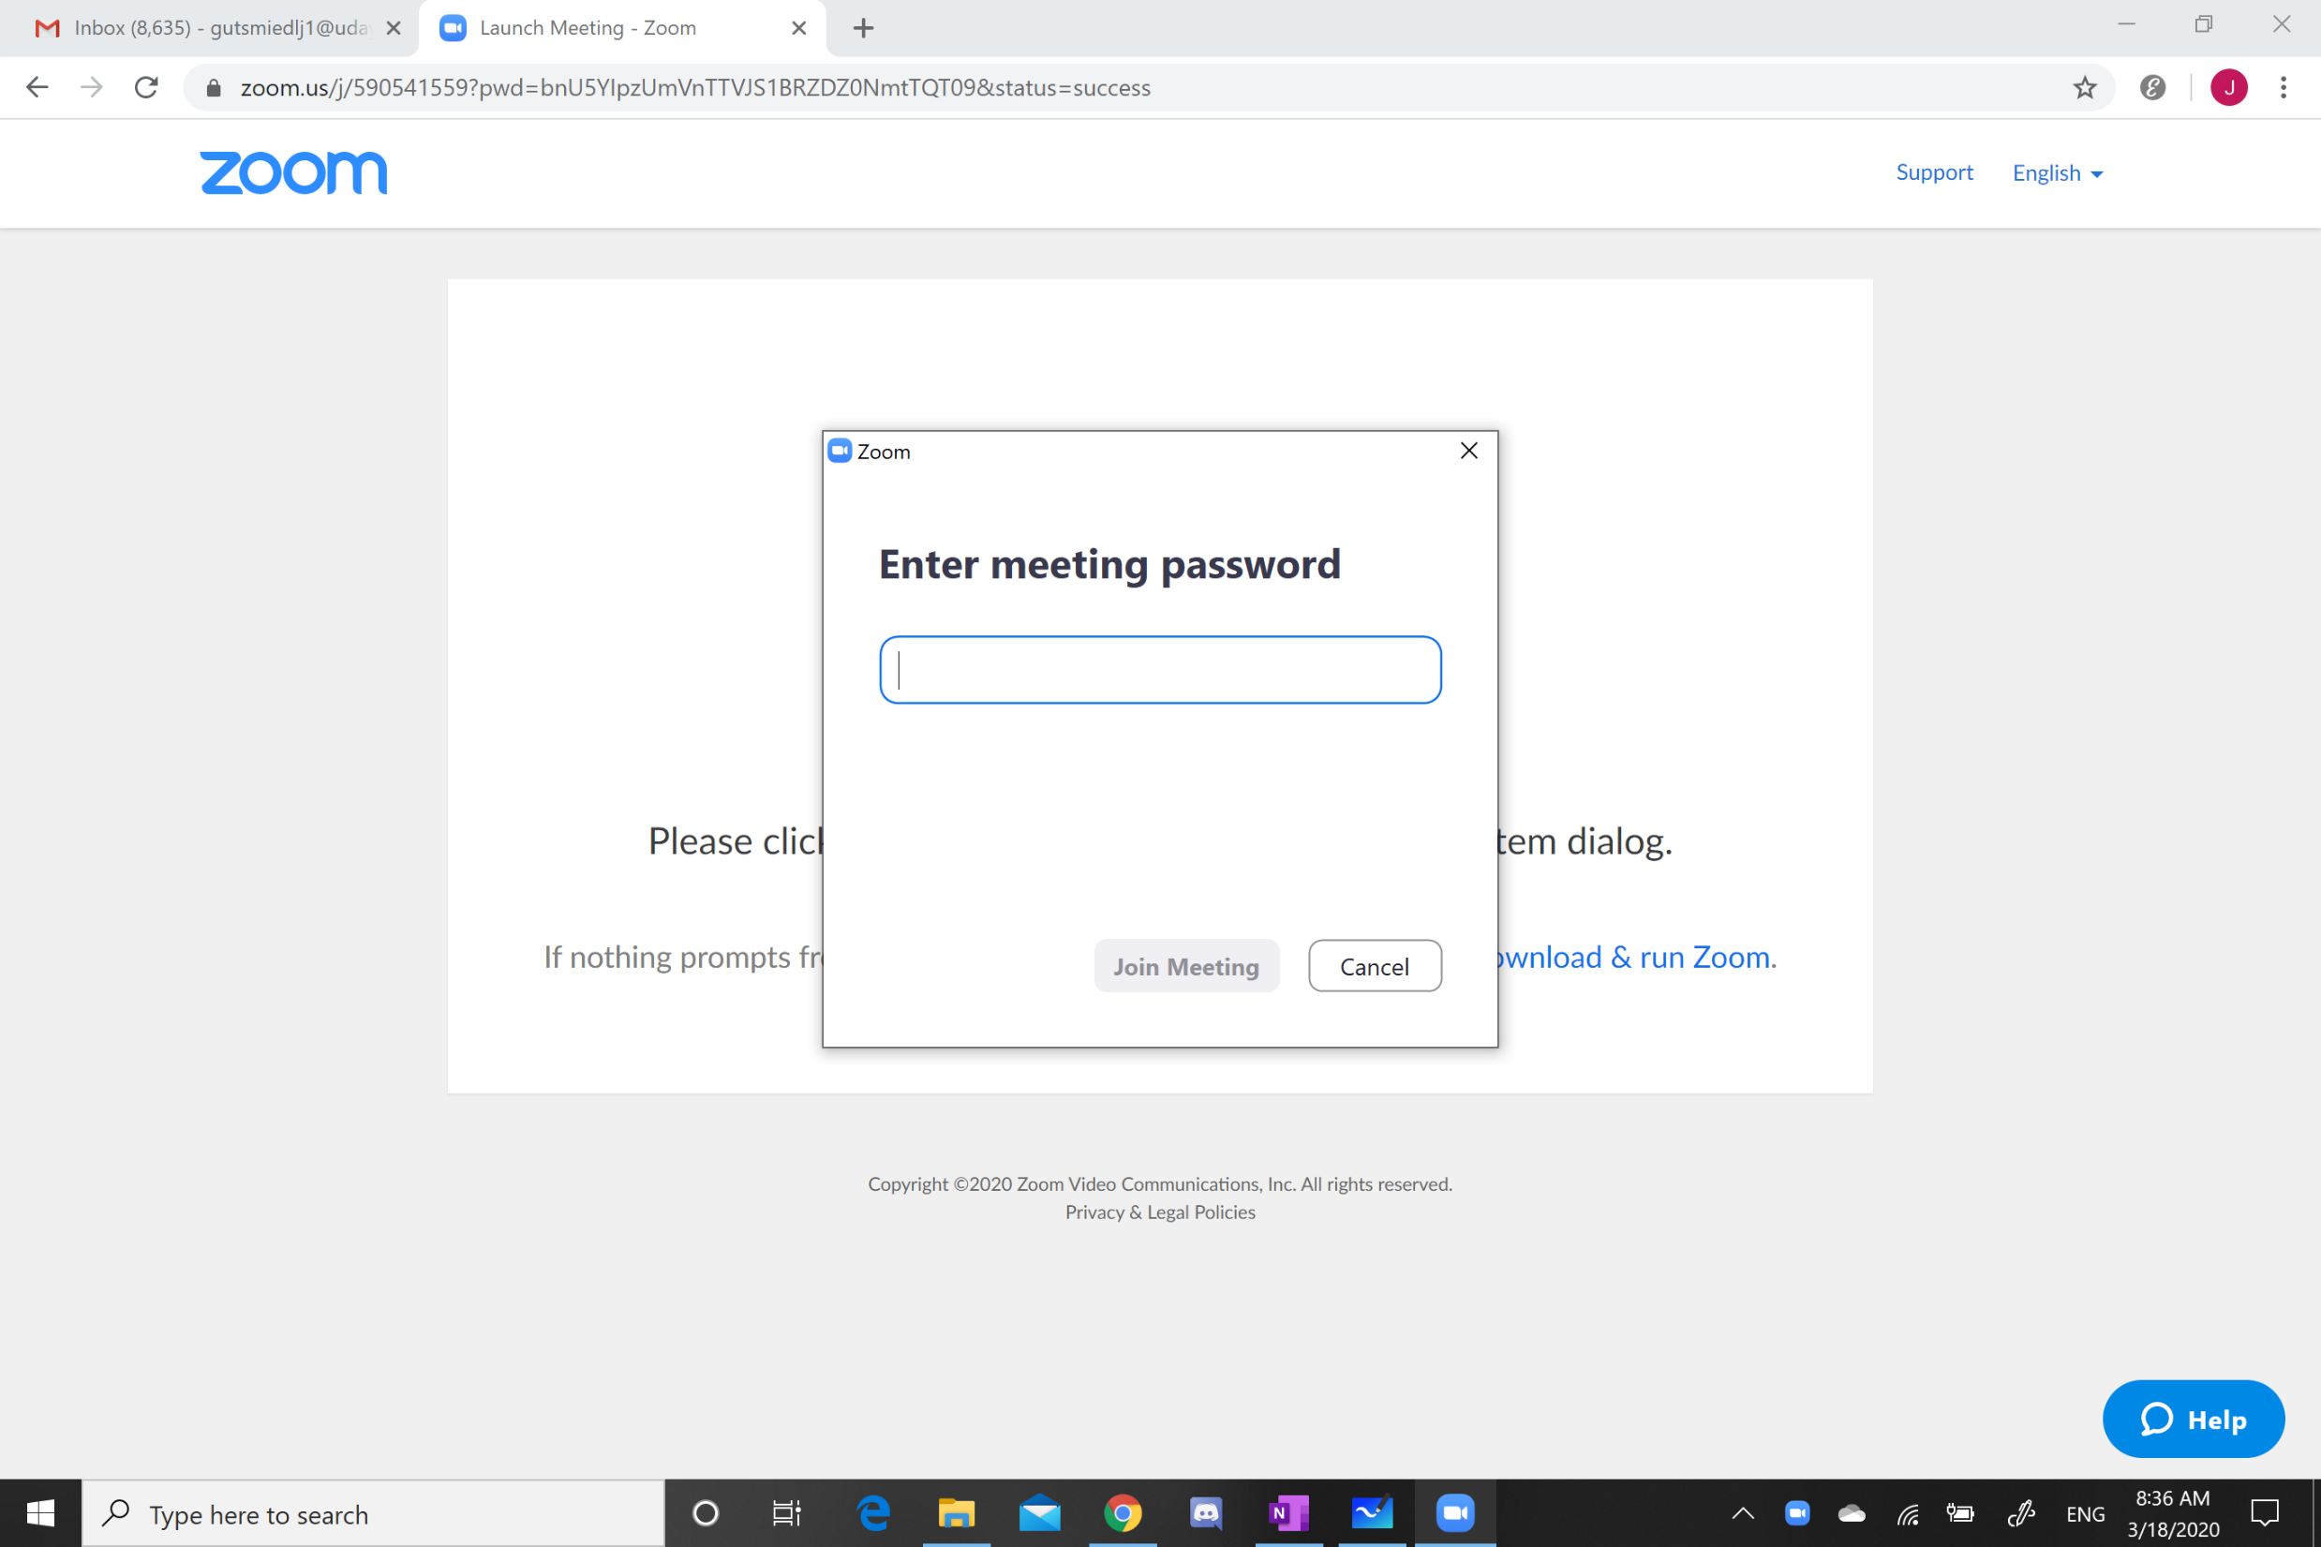
Step 4
Step 5

Slide 7
1. Connecting Online (cont.)
A scree should now appear with a blue button that says “Join with Computer Audio.” Please press that button
Once you have pressed that you are connected and you will see a screen with meeting information and different buttons

Slide 8
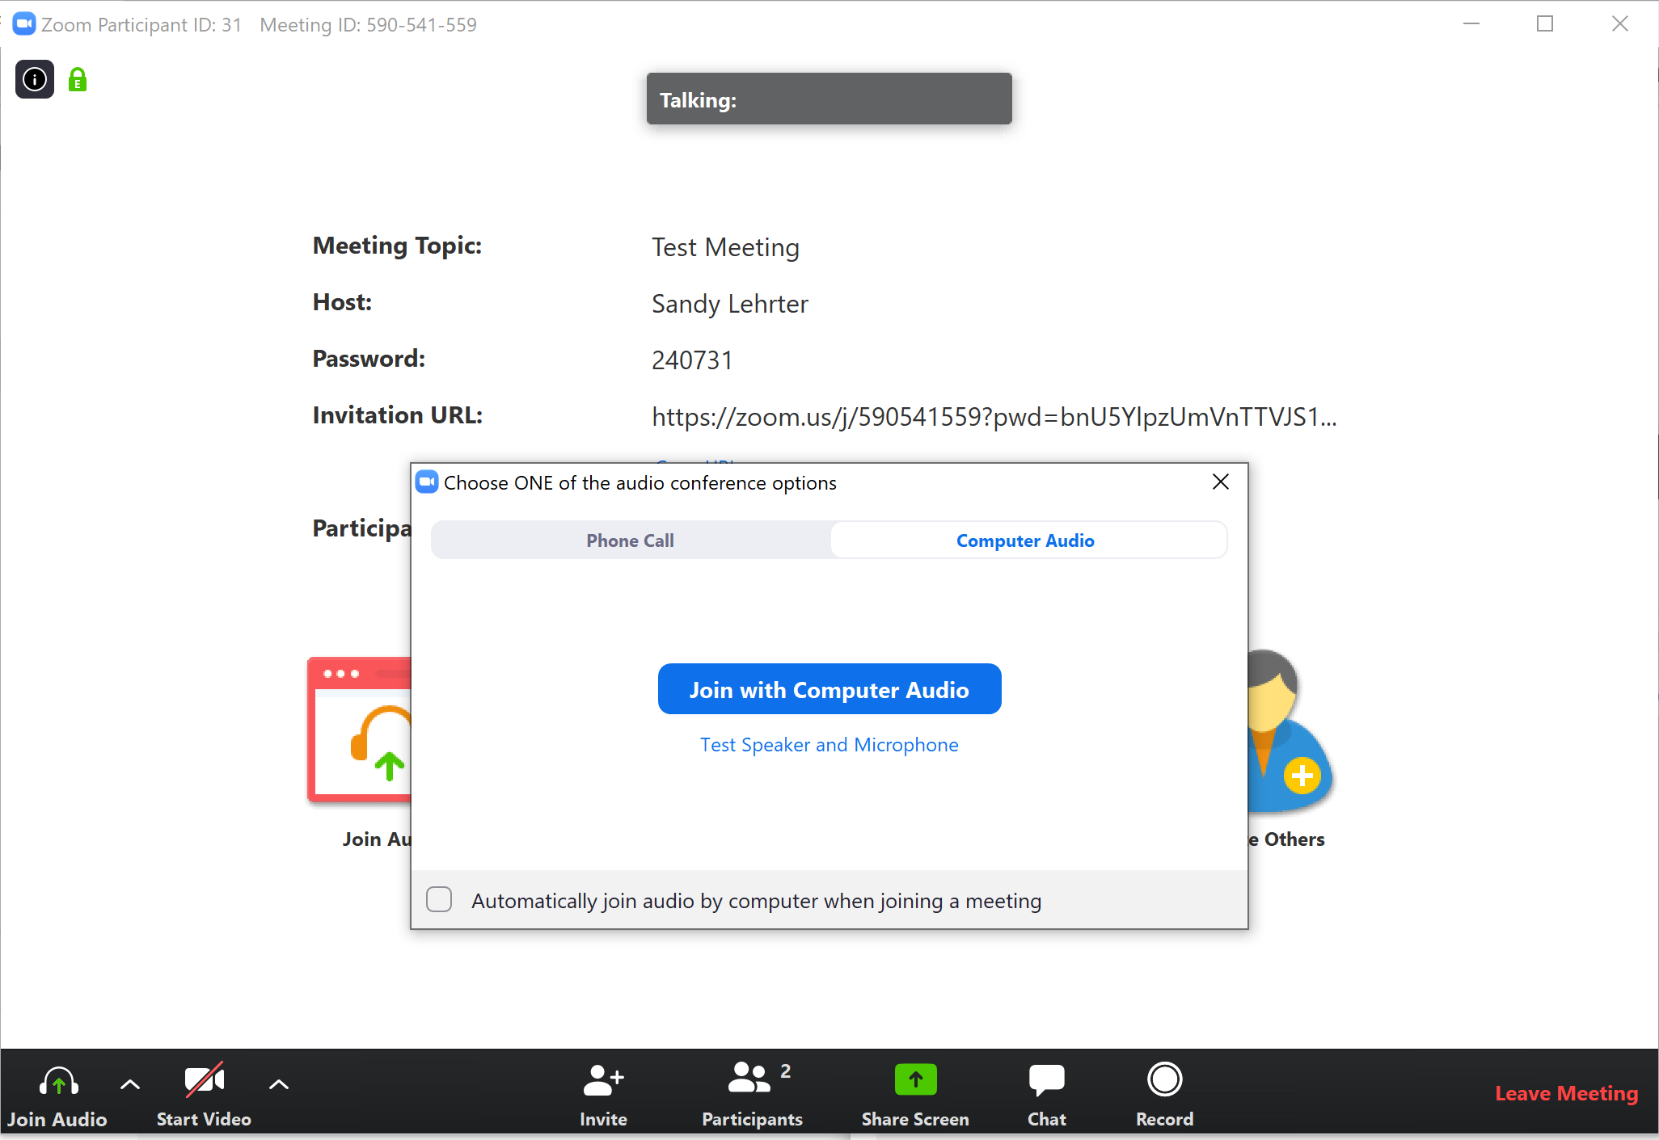
Step 6

Slide 9
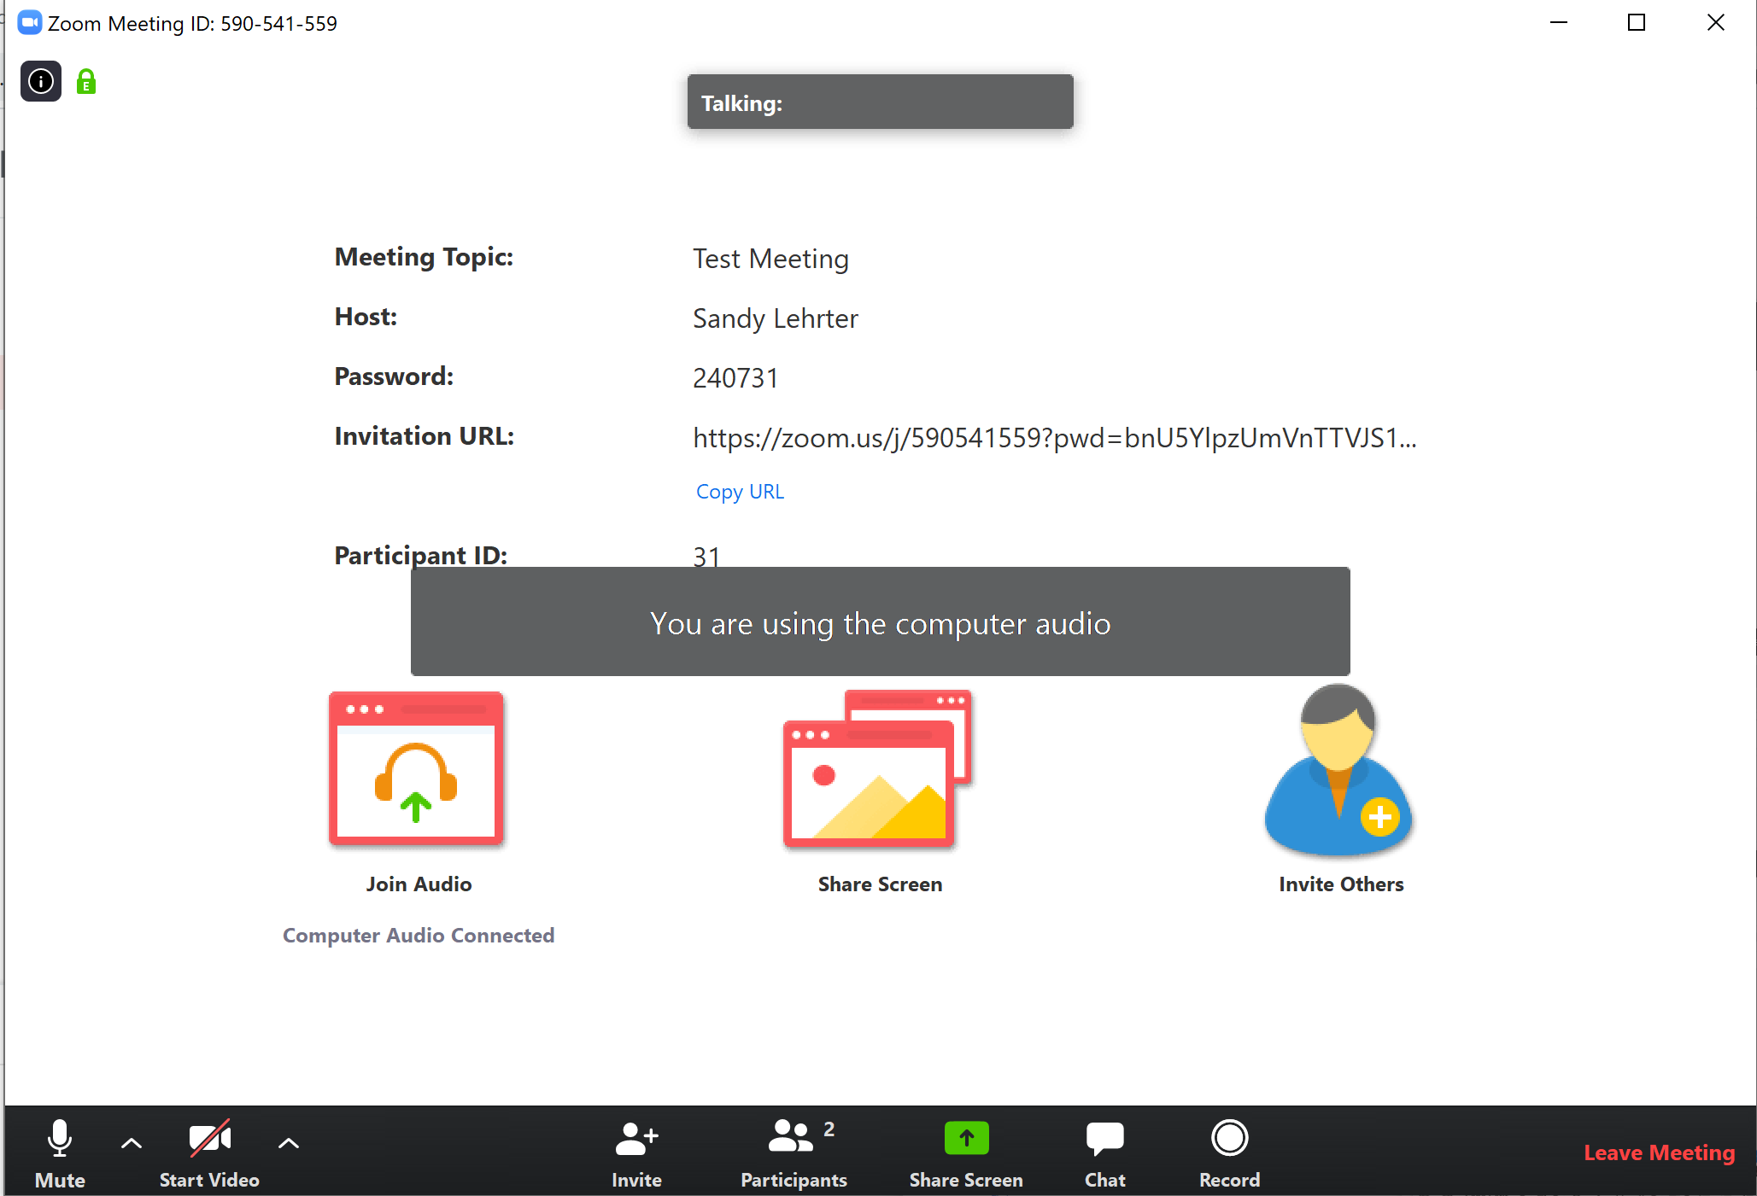
Step 6
Share your screen
Record Meeting
Mute
Turn on Webcam
Number of people in the meeting
Use Text Chat

Slide 10
2. Connecting Over the Phone
Dial the number given to you (probably provided over email)
Follow the instructions and enter the Meeting ID and the Meeting Password when prompted

