Slide 1
2020 Drug Shortage UPDATE
27May2020 - J Russell

Slide 2
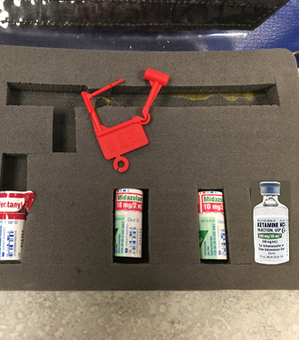
2020 Drug Bag UPDATE: MIDAZOLAM 10mg/2ml vial SHORTAGE!! 10mg/2ml vials will be replaced with 5mg/1ml vials

Slide 3
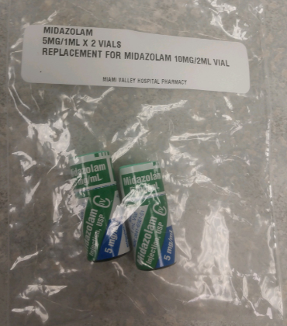
2020 Drug Bag UPDATE: MIDAZOLAM 10mg/2ml vial SHORTAGE!! You will now have (4) 5mg/1ml vials in the drug bag!! DOSING WILL NOT CHANGE!!

Slide 4
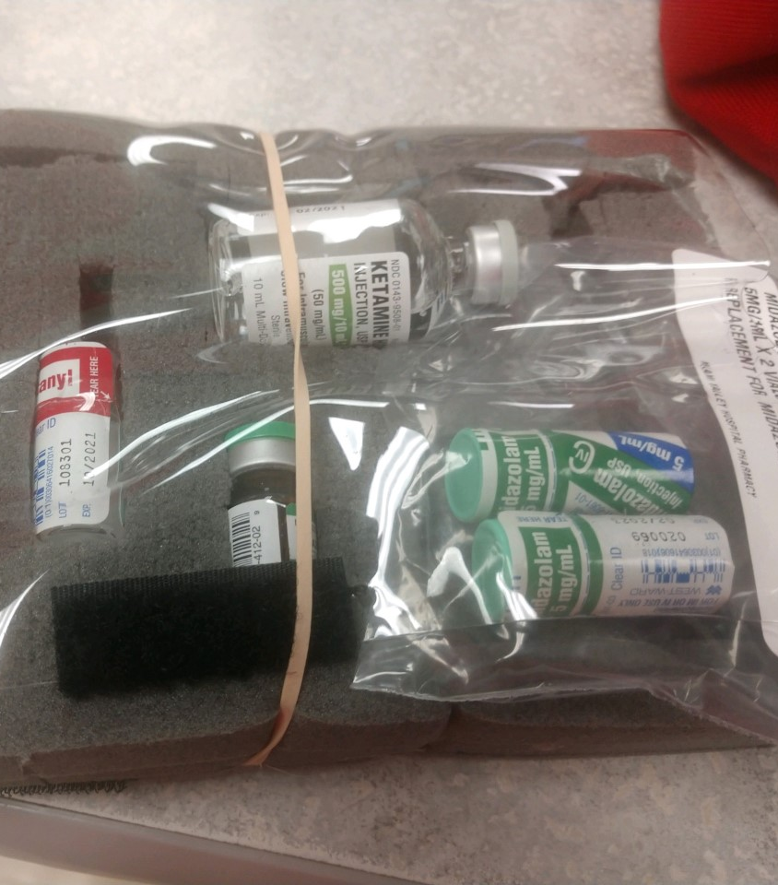
2020 Drug Bag UPDATE: This shows the 5mg/1ml vials stored in the drug bags DOSING WILL NOT CHANGE!!

