Slide 1
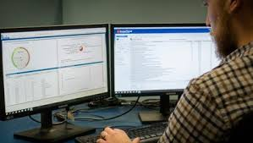
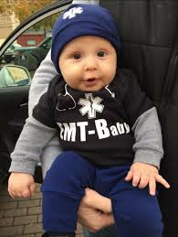
ESO for EMS
Coming to Dayton Children’s early Fall 2021

