Slide 1
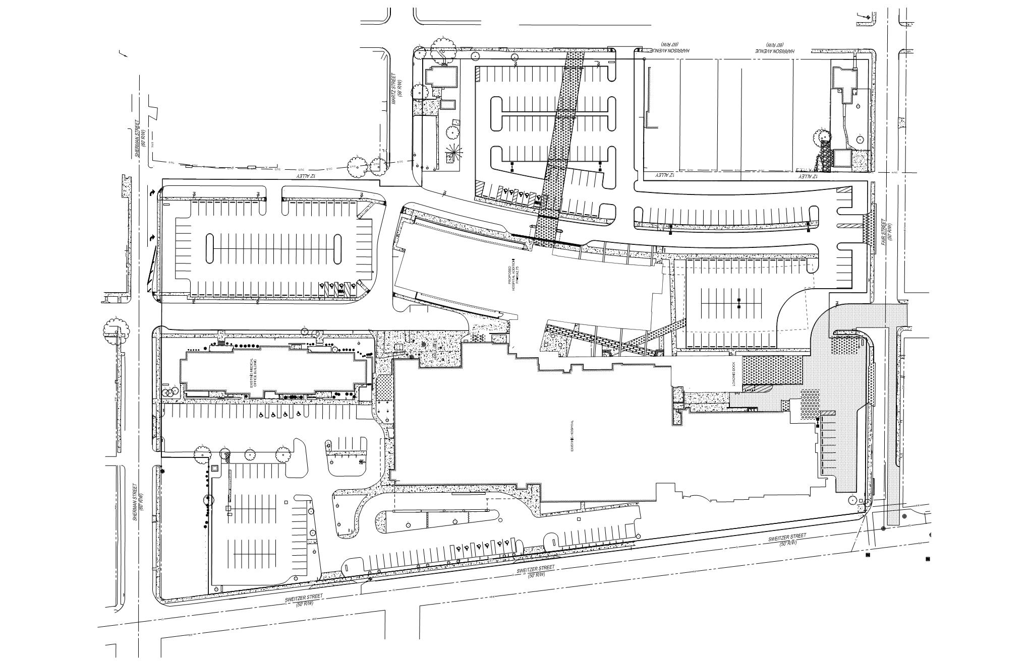
Residential
North
Fair Street
Hospital
Central Ave
Sherman Street
Ambulance Entrance
Hospital
Sweitzer Street

