Slide 1
Training Individuals Furnished Naloxone
Use laminated or handout training slides:
Provide information regarding agencies that can assist people with opioid addictions (e.g., PHDMC Addiction Business Card)
Indications for naloxone
How to respond to an opioid overdose:
Activate EMS
Clear airway
Rescue breathing
Administer naloxone
Repeat dose in 2-3 minutes if no response
Recovery position
Provide project DAWN phone number
Process for using the Narcan Nasal Spray
Proper storage temperature
Expiration date

Slide 2
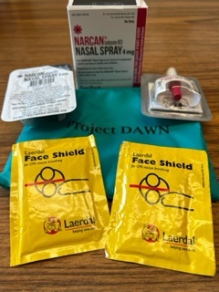
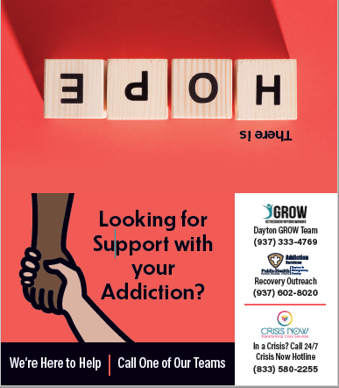
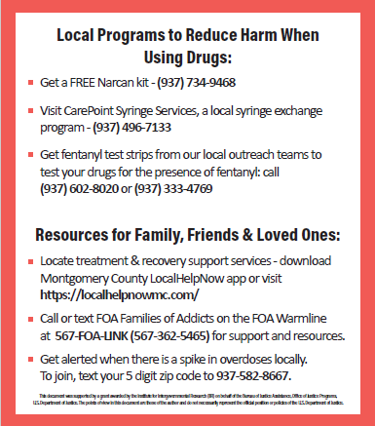
Project Dawn Kit 2 Narcan Nasal Sprays
Addiction Business Card
Local Programs to Reduce Harm When Using Drugs
Resources for Family, Friends & Loved Ones

Slide 3
Naloxone Quick Facts
Antidote to an opioid overdose
Only reverses overdose due to opioids
Has no effect on any drug other than an opioid
If given to someone not experiencing an opioid overdose, no harmful effects will be experienced
Individuals dependent on opioids may experience withdrawal symptoms after receiving naloxone
Withdrawal due to opioids is not life-threatening
No potential for abuse
Can’t get high on naloxone, can’t overdose

Slide 4
Naloxone Quick Facts Continued…
Lasts only 30-90 minutes
Heroin overdose can last up to 2 hours
Some opioids last longer than heroin and have higher potential for overdose to recur after naloxone wears off
An overdose victim should get medical care
– If bystanders are unwilling to call 911, victim must be monitored to ensure the overdose does not recur after Narcan has worn off
Taking more drugs right after being given Narcan will not alleviate withdrawal symptoms, but will make recurrence of overdose more likely

Slide 5
How can you identify an opioid overdose?
The person who is overdosing exhibits the following symptoms:
Blue skin tinge (usually lips and fingertips show first)
Body limp
Face pale
Pulse (heartbeat) is slow, erratic, or not there at all
Throwing up
Passing out
Choking sounds or gurgling/snoring sounds
Breathing is very slow, irregular, or has stopped
Awake, but not able to respond

Slide 6
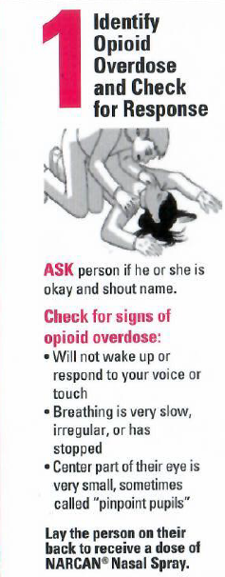
OD Response Step 1: Assess
Step 1: Assess the signs to confirm person is experiencing an overdose
Unresponsive
No signs of breathing or breathing is shallow
Snoring or gurgling noises
Fingernails and/or lips blue or ashen depending on skin color

Slide 7
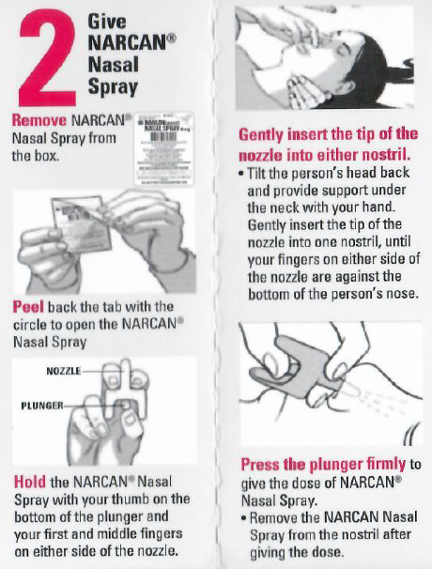
OD Response Step 2: Give Narcan Nasal Spray

Slide 8
Overdose Rescue Street Methods (What NOT to do)
People have tried various methods to revive OD victims
Applaud their efforts while helping them understand that it is safer and more effective to use naloxone and call 9-1-1
Street methods may include:
Injections (salt water, cocaine, milk, suboxone)
Putting victim in a shower/bath
Ice, water
Punching, slapping, etc.
Induced vomiting

Slide 9
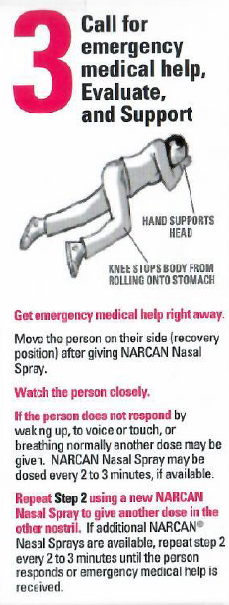
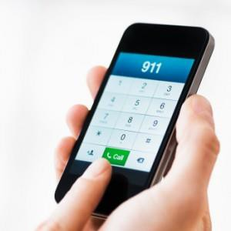
OD Response Step 3: Activate EMS

Slide 10
OD Response
Recovery Position
If the person must be left alone-even for a few seconds, put into recovery position to avoid choking
Place person on side
Top leg bent at knee, bottom leg straight out
Bottom arm extended straight above head, top arm bent at elbow with hand under face as if it were a pillow

Slide 11
Proper Storage
Keep out of direct light
Store at room temperature
Between 59-86 degrees F
Should not be subjected to extreme temperatures

Slide 12
What happens after naloxone expires?
Naloxone loses potency after expiration date
Expired naloxone can still save a life but more may be needed to have the same effect
Keep expired naloxone even after a refill has been obtained

