Slide 1
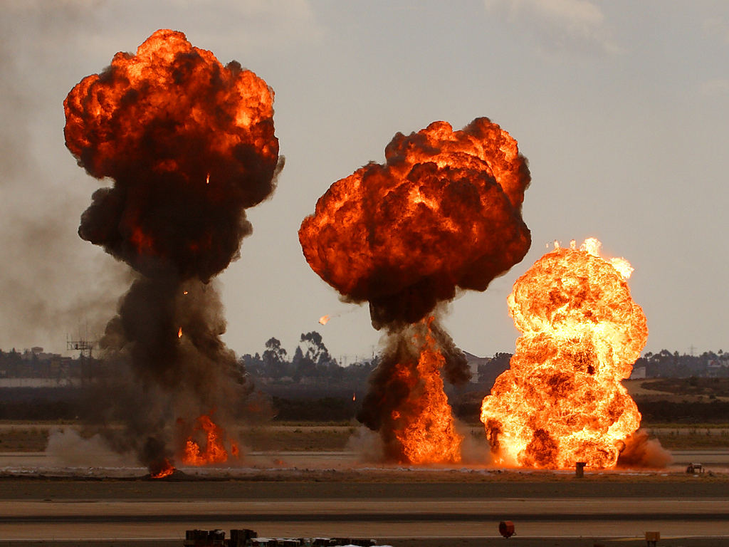
Federal Bureau of Investigation
Cincinnati Division
June 13, 2018
Chemical Industry Outreach Workshop
Butler Tech Public Safety Education Complex
5140 Princeton-Glendale Rd.
Liberty Township, Ohio 45011
AGENDA
Registration 7:45a.m. – 8:15 a.m.
Introductions 8:15 a.m. – 8:30 a.m.
Welcome/Workshop Briefings
FBI WMD Chemical 8:30 a.m. – 9:00 a.m.
Outreach Program WMD Directorate
National Overview
FBI Field Perspective 9:00 a.m. – 9:45 a.m.
Cincinnati WMDC
Break/Networking 9:45 a.m. – 10:00 a.m.
Chemical Precursors/IEDs 10:00 a.m. – 11:15 a.m.
SABT Field Office Cincinnati SABT
Lunch (on your own) 11:15 a.m. – 12:45 p.m.
Travel/Report to Range 12:45 p.m. – 1:00 p.m.
Demonstration 1:00 p.m. – 2:45 p.m.
SABT/Bomb Squads
Debriefing 2:45 p.m. – 3:00 p.m.
RSVP with name(s), title(s), agency/company and points of contact by 6/6/2018
to:
Richard.Maier@ic.fbi.gov or (513) 979-8307
* *Dress casual, and for the weather that day. Outdoor range visit is second half of the day.

