Slide 1
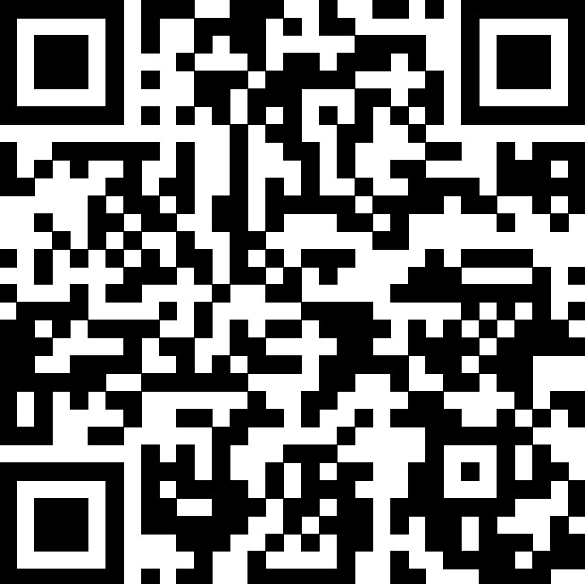
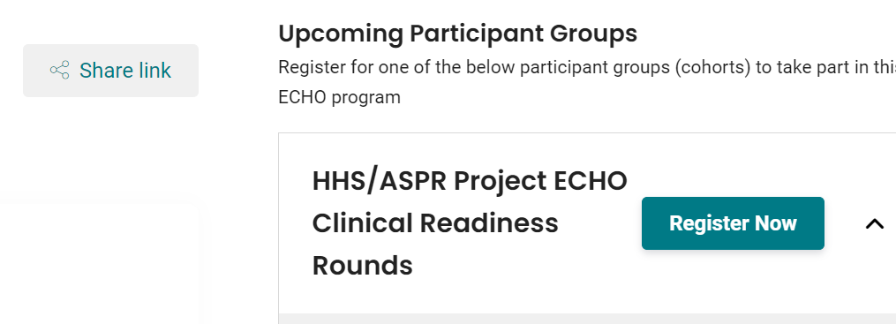
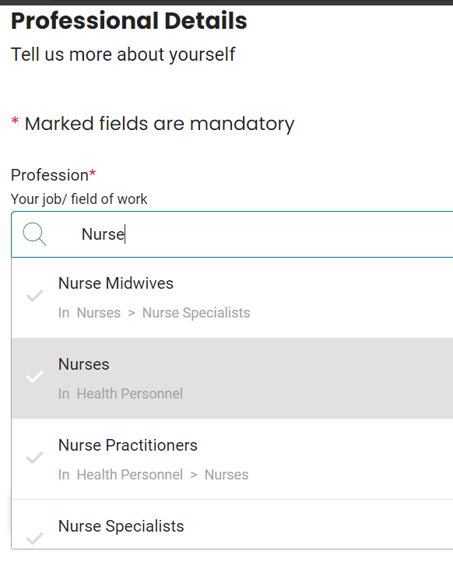
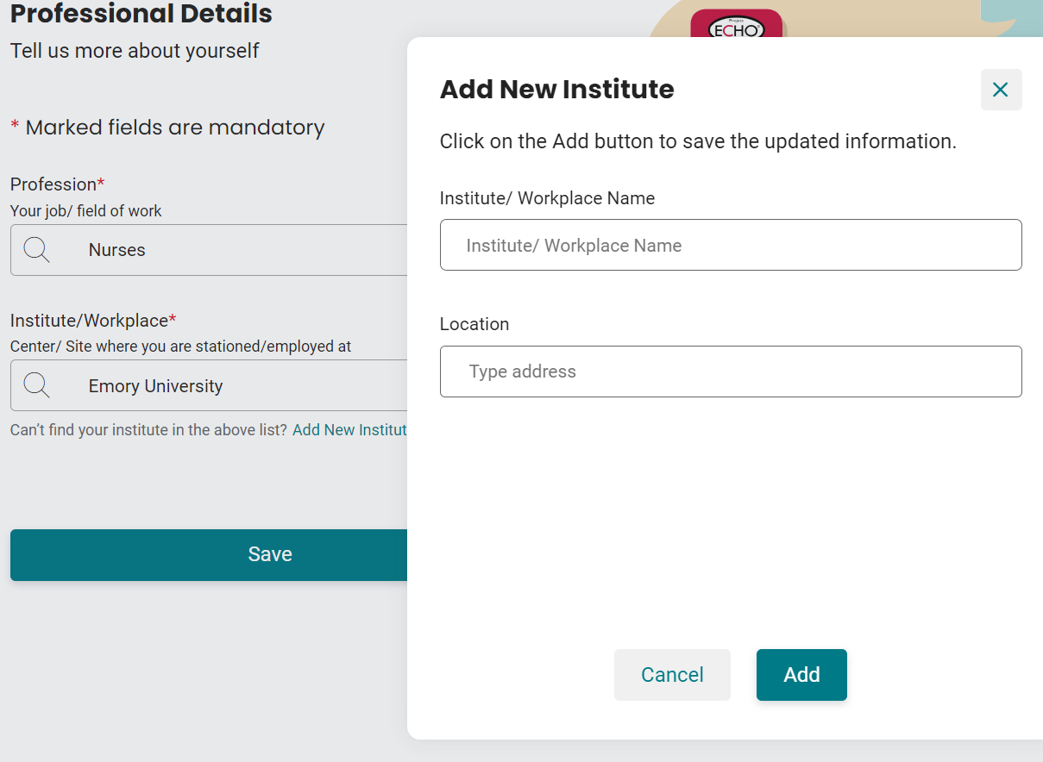
HHS/ASPR Project ECHO Clinical Readiness Rounds
How to register for sessions
This step-by-step guide walks you through creating an iECHO account, which will register you for all upcoming Clinical Readiness Rounds sessions and allow you to access each event and recording.
1
Access the iECHO platform: Select here or scan the QR code to the right.
2
Select “Register Now:” The teal button can be found below the “Upcoming Participant Groups” header, as shown below:
iECHO Platform
3
Make an iECHO account. Select your preferred language, and choose to create an account via an email, mobile number, or Google account.
4
Share additional information. Enter your first and last name, choose whether to disclose your gender, create a password, read and accept the terms and conditions, and press continue.
5
Authenticate your new account: Enter the six-digit code sent to your email address or mobile device. Then, press “continue.”
6
Provide your profession. Begin typing your profession and choose from the dropdown list that generates.
If you do not see an option for your profession after typing it in, please type “other” and select the first option that says “other.”
7
Select your institution. Begin typing your institution and choose from the dropdown menu.
If you do not see a match, click "Add New Institution," complete the name and location fields, and click "Add."
8
Finish up. Enter your time zone and location, choose your profile privacy preference, and press confirm.
Guide Continues on Back: Learn how to stay in the loop →
Last Updated August 2025

Slide 2
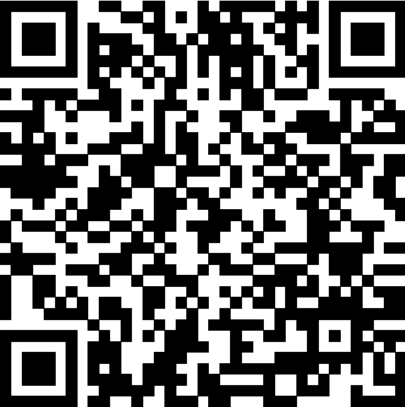
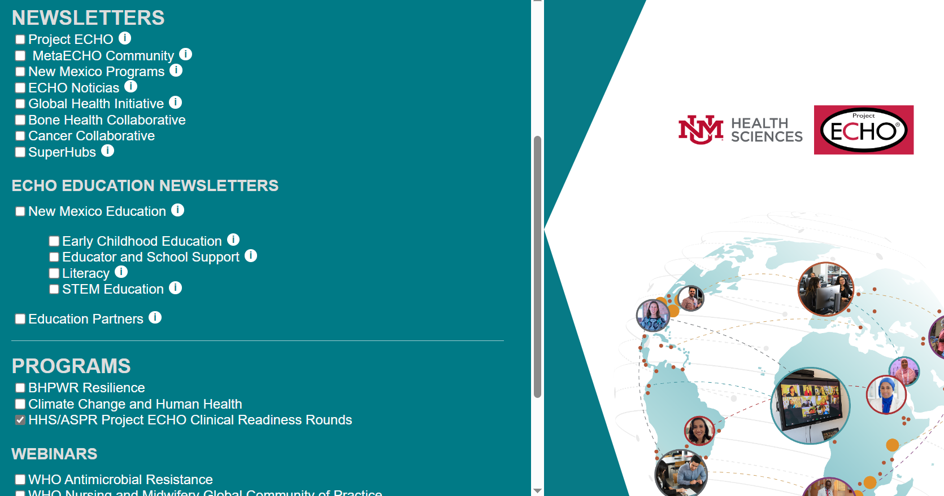
How to Stay in the Loop for Upcoming Sessions
With an iECHO account, you are registered for all future sessions, and you can access session materials and recordings easily via the iECHO platform.
To ensure you get email reminders about upcoming sessions and other resources, please sign up to receive news and reminders!
Sign Up for Clinical Readiness Rounds Email News and Reminders!
1
Select here or scan the QR code on the right.
2
Check the “HHS/ASPR Project ECHO Clinical Readiness Rounds” box under the “Programs” header. Example below.
Enter your first and last name, email address, organization name, ZIP Code, and country.
iECHO Newsletter
3
4
Add no-reply@iecho.org to your trusted senders list to avoid session reminder emails going to your spam folder.
Remember to follow ASPR on social media (@ASPRgov on all platforms) to get the latest information on the Clinical Readiness Rounds.
We look forward to seeing you at the next Clinical Readiness Rounds session!
Last Updated August 2025

Slide 3
HHS/ASPR Project ECHO Clinical Readiness Rounds
Supporting the health care workforce and providing real-time, peer-to-peer knowledge sharing to facilitate all-hazards preparedness and response.
Overview
The Clinical Readiness Rounds, led by ASPR’s Office of Health Care Readiness in partnership with the University of New Mexico’s Project ECHO, focus on sharing clinical challenges and successes in preparing for, responding to, and recovering from disasters from all threats. Importantly, they support the health care workforce.
The Clinical Readiness Rounds serve as a critical mechanism for a multidisciplinary audience of clinicians to rapidly share promising practices for medical preparedness and response to disasters. Sessions might address topics such as:
Health Care Workforce Retention and Wellbeing
Rural Emergency Medical Services
Clinical Care Considerations for Specific Threats
Patient Movement Considerations
Mitigating Medical Surge
Medical Operations Coordination Centers
Continuing Medical Education (CME), Continuing Nursing Education (CNE), and Continuing Education for Emergency Medical Services credits will be available to participants who complete a Clinical Readiness Rounds session.
Scan to Register for the Clinical Readiness Rounds
Sessions are held the second Tuesday of each month from 12:00 – 1:15 PM ET (UTC-5).
Scan the QR code or select here to register online.
Multidisciplinary Clinical Audience
Peer-to-Peer Knowledge Sharing and Support
Evolving Topics
Clinical Experience vs. Guidance
Continuing Medical Education (CME) and Continuing Nursing Education (CNE) Credit
Readiness for All Threats
Supporting the Health Care Workforce
Last Updated August 2025

